Slide 1
Week-4 Tutorial
Course code: CSE231
COURSE NAME: operating system

Slide 2
Makefile
Setup and Installation
Creating Simple Makefile
Advance Features in Makefile

Slide 3
GNU Makefile
It makes compilation easy and predictable and also saves time and resources by compiling only the necessary files
For Ubuntu, you need to run the following command for installing gnu make
sudo apt update && sudo apt install build-essentials
For Artix Linux
sudo pacman -S make

Slide 4
Creating a simple Makefile
There are three basic things you have to know
Source files: The files are written in .c / .cpp you want to compile
Target files: The binary files are created after compilations
Dependencies: All the dependencies should exist before compilation

Slide 5
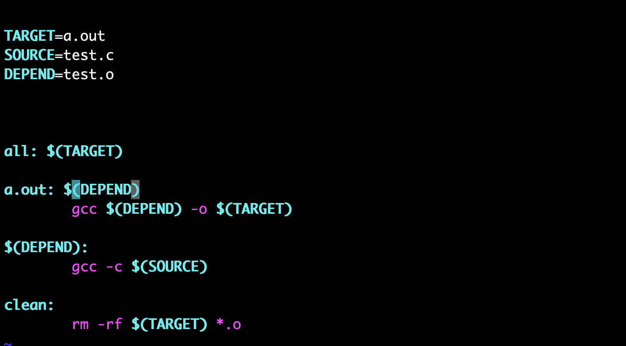
How mAKEFILE LOOKS LIKE
Source: Find code in week-4-tutorial/makefile/code/v1

Slide 6
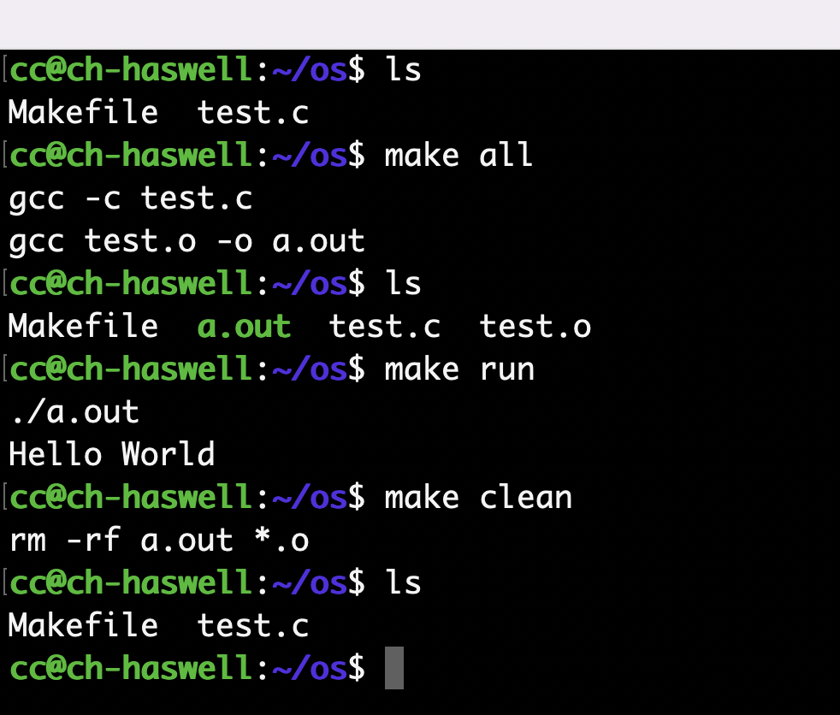
How to run it
Compile your test.c file using Makefile
make all or make
you can see a.out binary file has been created
Run a.out using Makefile
make run
It prints Hello World (output of test.c file)
Clean / remove all binaries using Makefile
make clean
It removes all .o files and a.out
Source: Find code in week-4-tutorial/makefile/code/v1

Slide 7
Advance topic in Makefile
Adding CFLAGS or CXXFLAGS and including header files (.h) using -ɪ flag
Creating assignment variables
Creating a shared library
Linking your code with a shared library using - L flag
Automatic Variables in Makefile

Slide 8
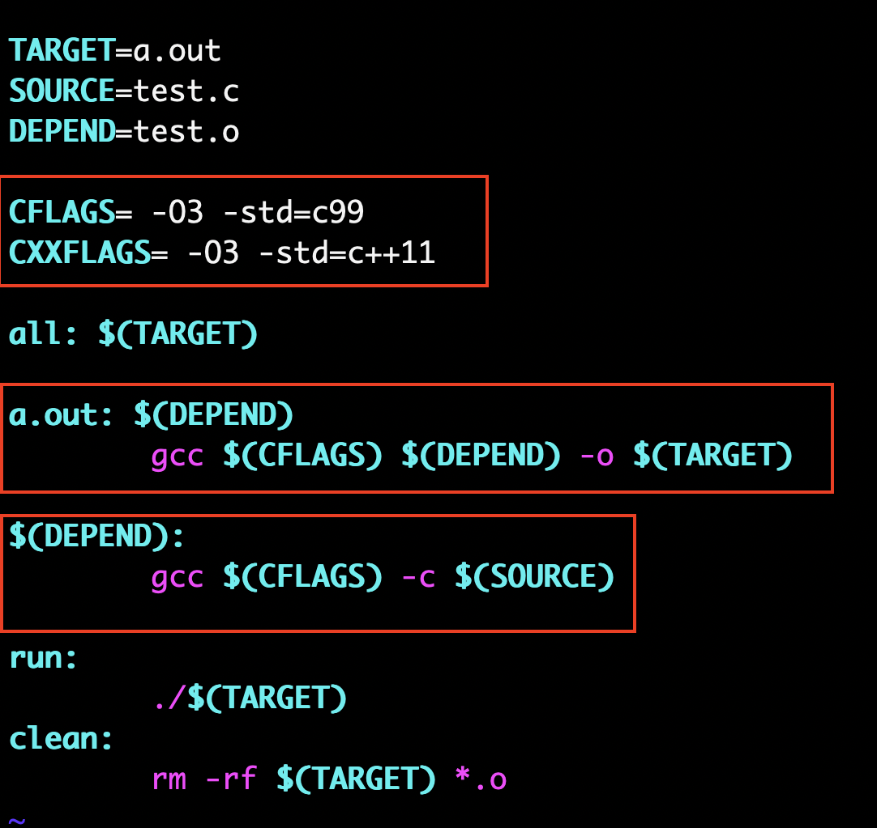
Adding flags IN mAKEFILE
Source: Find code in week-4-tutorial/makefile/code/v2

Slide 9
Creating ASSIGNMENT VARIABLES
There are four different assignment operators
Simple assignment (:=) : A simple assignment expression is evaluated only once, at the very first occurrence.
Recursive assignment (=) : A Recursive assignment expression is evaluated every time the variable is encountered in the code.
Conditional assignment (?=) : Conditional assignment assigns a value to a variable only if it does not have a value
Appending (+=) : It will append a new value to the previous value with space separated

Slide 10
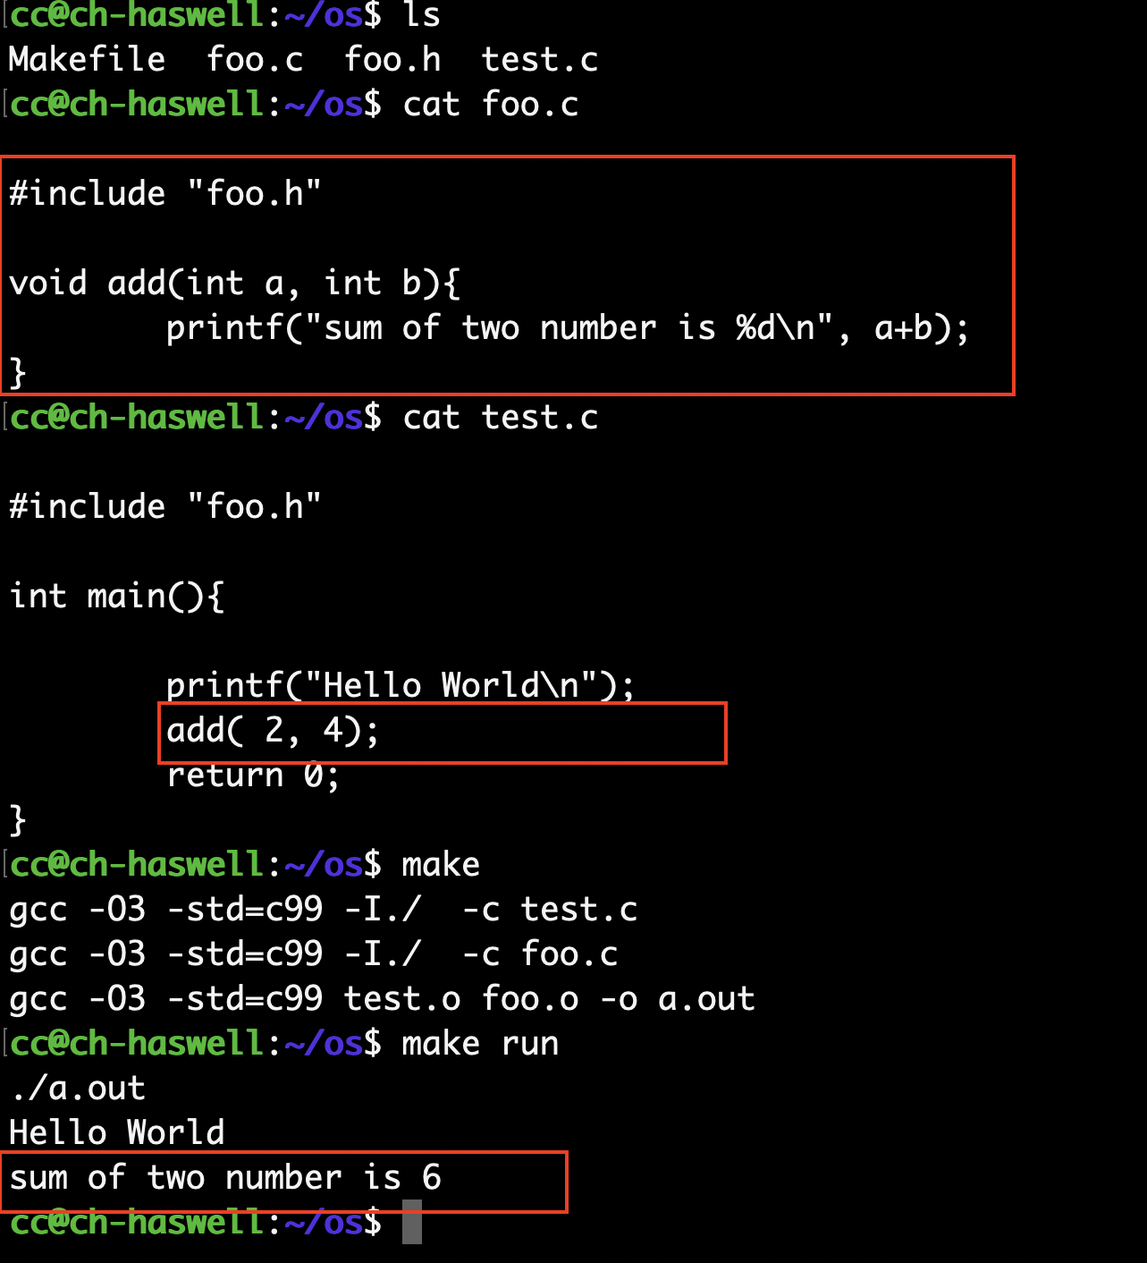
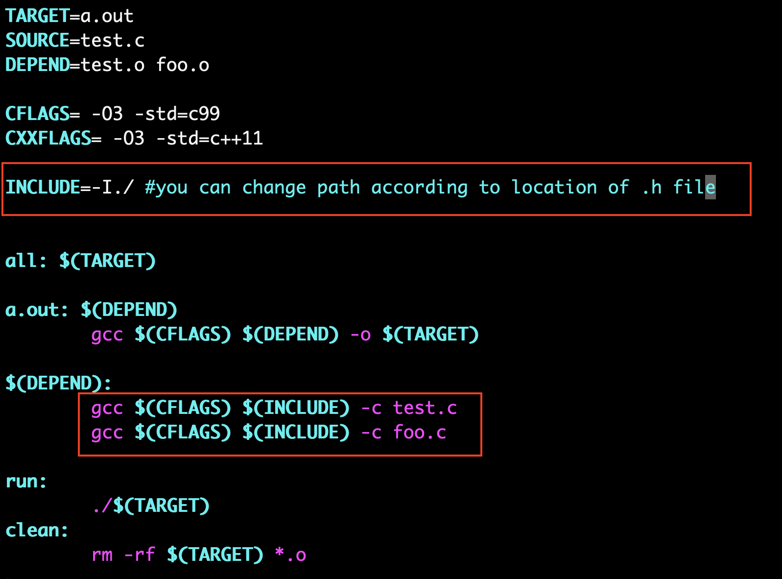
Including header files
Console Output
Changes in Makefile
Using – ɪ flag we can include header files resides in different folder by providing path to folder
Source: Find code in week-4-tutorial/makefile/code/v3

Slide 11
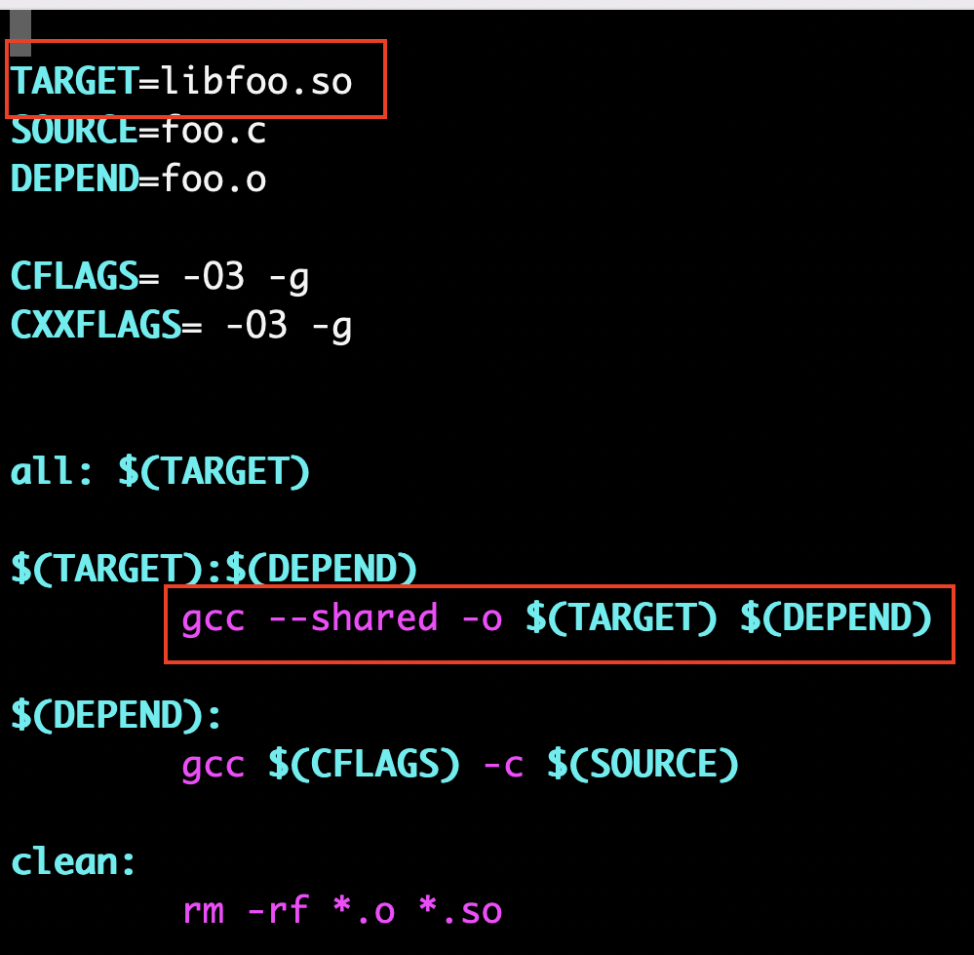
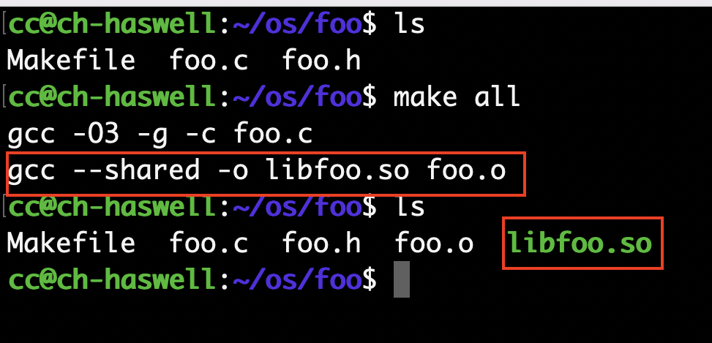
Creating Shared library (.so)
Changes in Makefile
Console Output
We also call it standalone libraries and you can call functions defined in libraries into your code using the linking mechanism
Linking mechanism is covered in the next slide
Source: Find code in week-4-tutorial/makefile/code/v4/foo

Slide 12
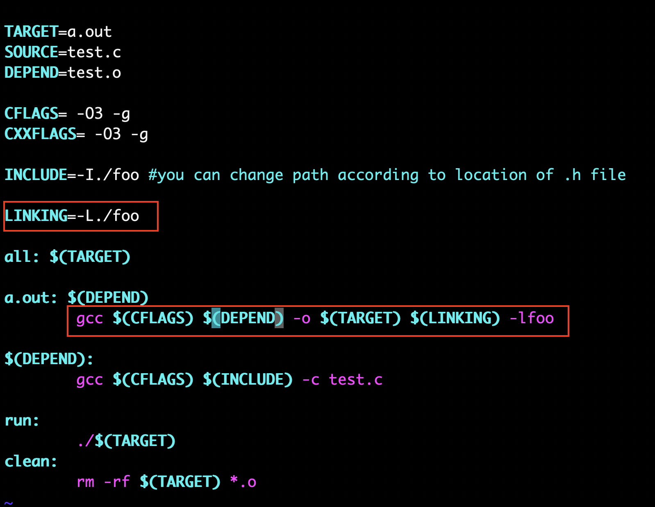
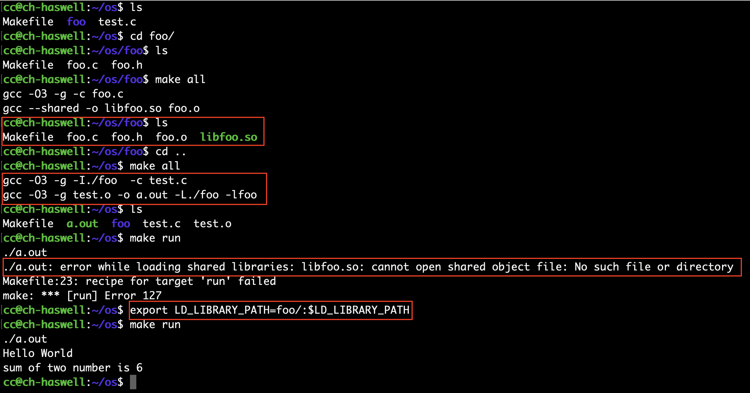
Linking shared libraries using - L flag
Changes in Makefile
Console Output
Set .so path to LD_LIBRARY_PATH env variable and make library available at runtime
Source: Find code in week-4-tutorial/makefile/code/v4

Slide 13
AUTOMAtic variables in makefile
$@ : The filename representing the target.
$< : The filename of the first prerequisite (all dependencies).
$? : The names of all prerequisites that are newer than the target, separated by spaces.
$^ : The filenames of all the prerequisites, separated by spaces. This list has duplicate filenames removed since for most uses, such as compiling, copying, etc., duplicates are not wanted.
Source: Find code in week-4-tutorial/makefile/code/v5

Slide 14
Reference material
https://www.gnu.org/software/make/manual/html_node/Concept-Index.html#Concept-Index
https://stackoverflow.com/questions/4879592/whats-the-difference-between-and-in-makefile
https://stackoverflow.com/questions/3220277/what-do-the-makefile-symbols-and-mean
https://earthly.dev/blog/g++-makefile/
https://iq.opengenus.org/create-shared-library-in-cpp/

Slide 15
Demo

